Slide 1
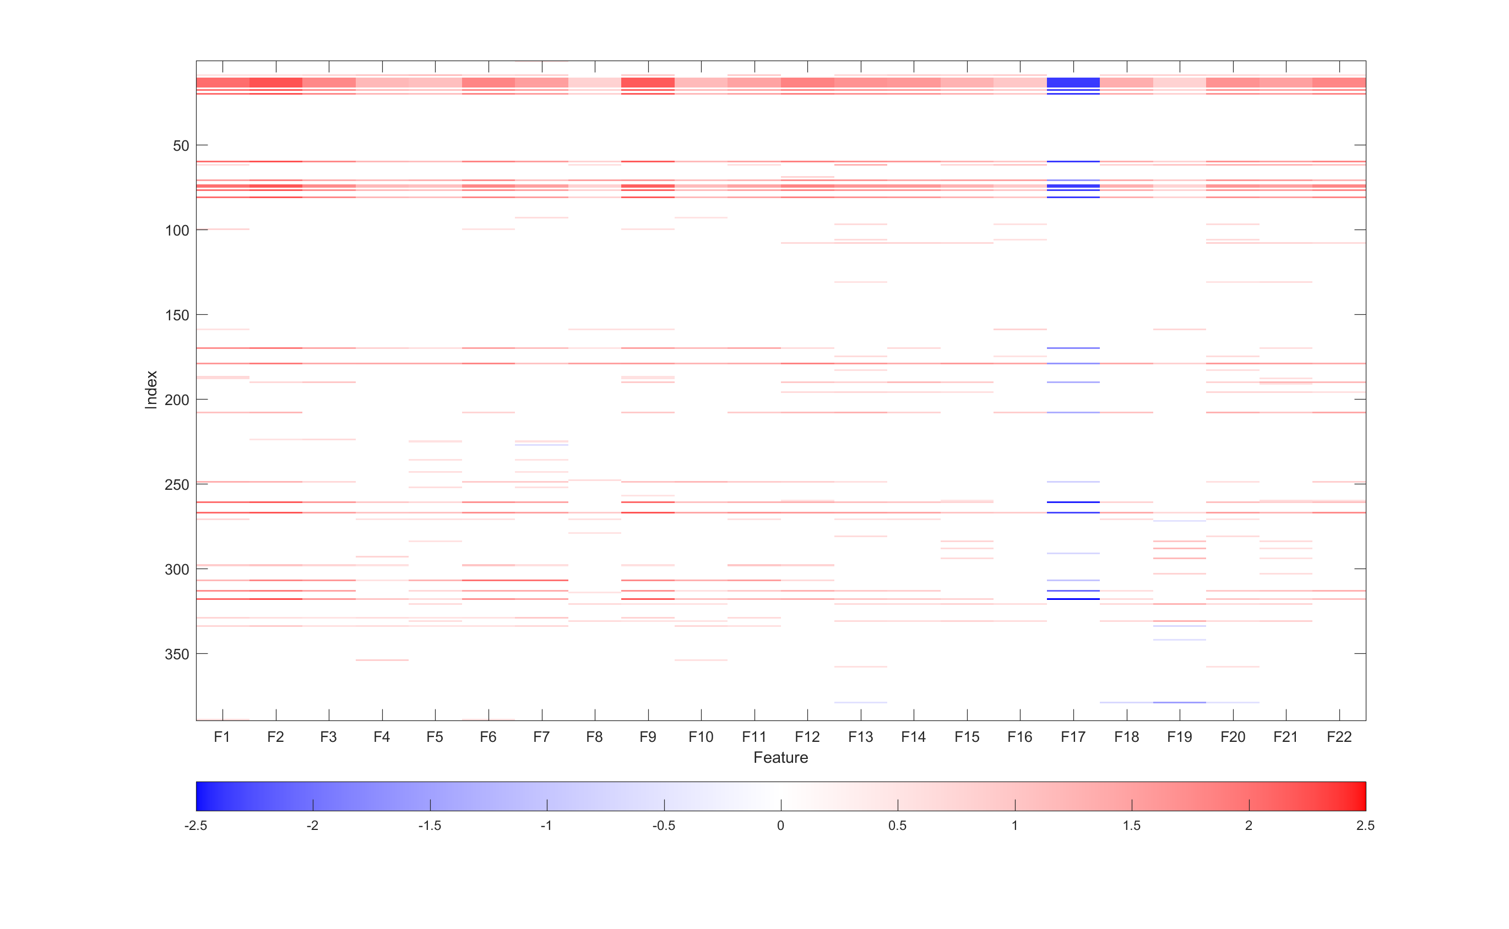
Extended in Figure 6
P Value < 1e-6
P Value > 1e-6
and P Value < 5e-6
P Value > 5e-6

Slide 2
